Slide 1
SeatSmart
Valuable Group Members:
Xie Han Keong
Jisa Mariam Zachariah
Loh De Rong
Jia Yunze
Lin Cheng
Yeh Swee Khim

Slide 2
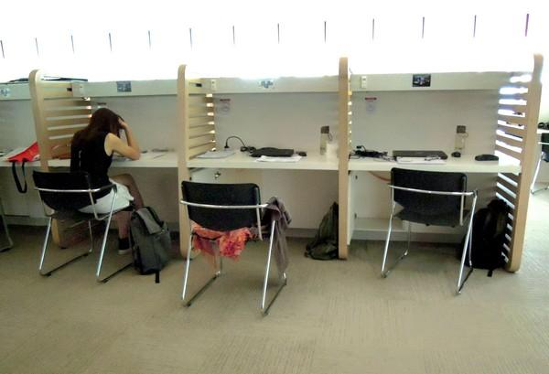
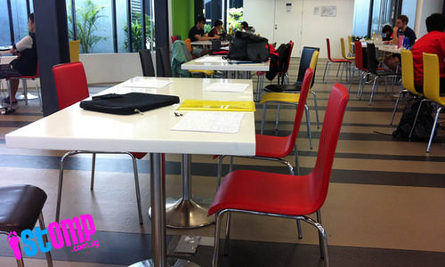
Seat hogging is a real social issue...
Notes:
This is seat hogging. Whether it is in the food court where people “chope” seats with tissue paper or students reserve seats in libraries and cafes with their belongings, it is a real issue and our group will be focusing on the issue of seat hogging in libraries.

Slide 3
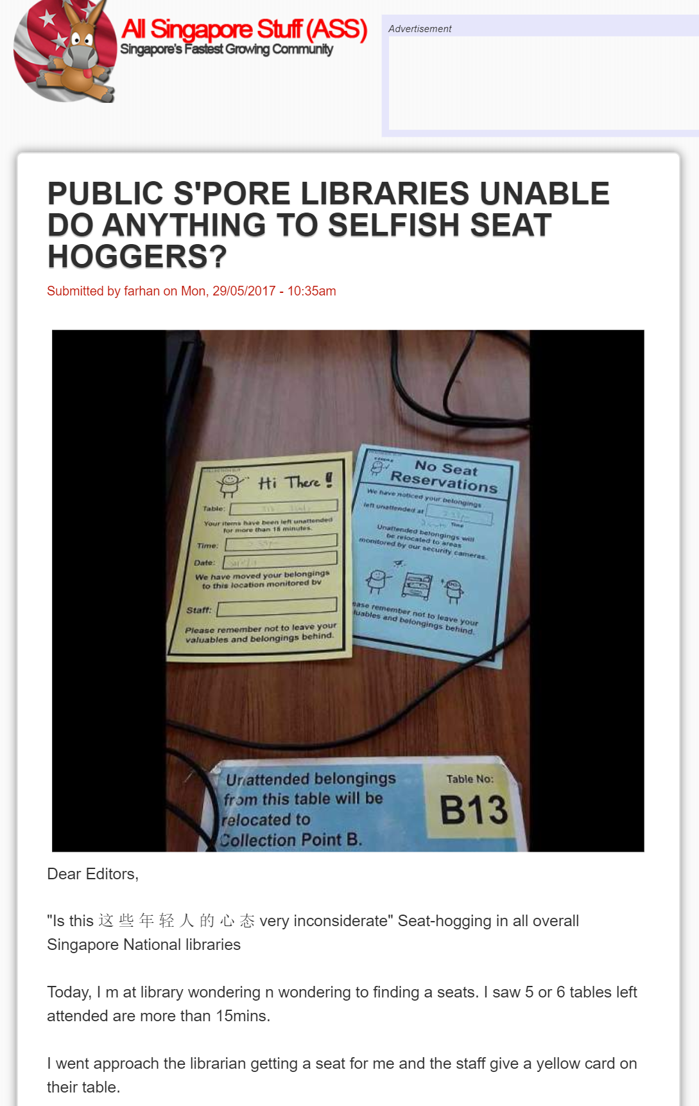
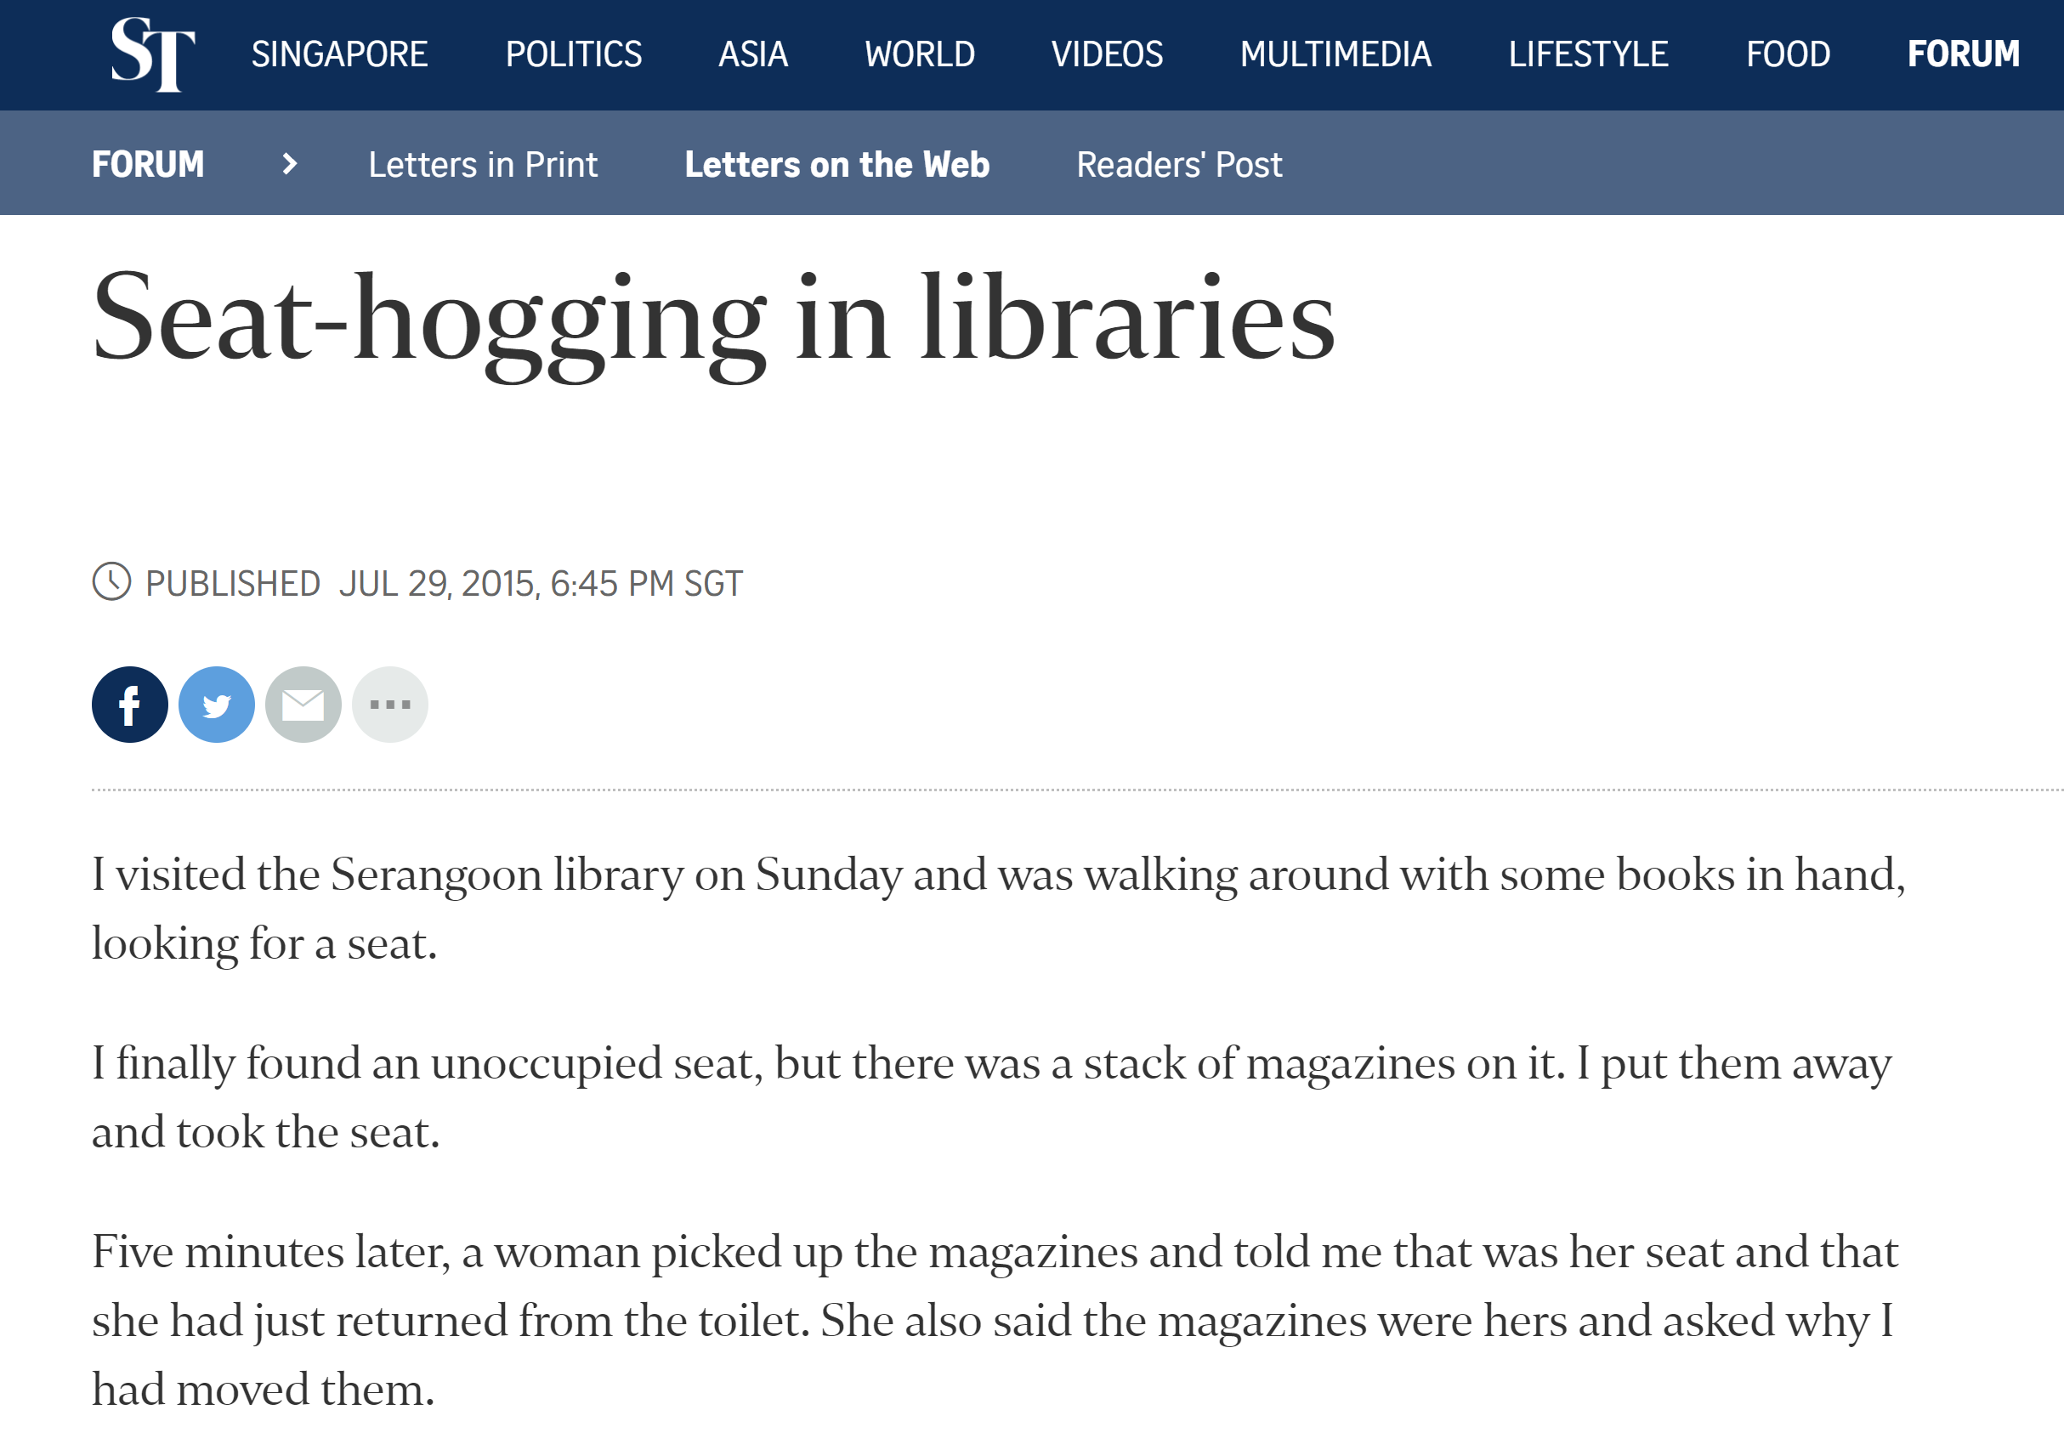
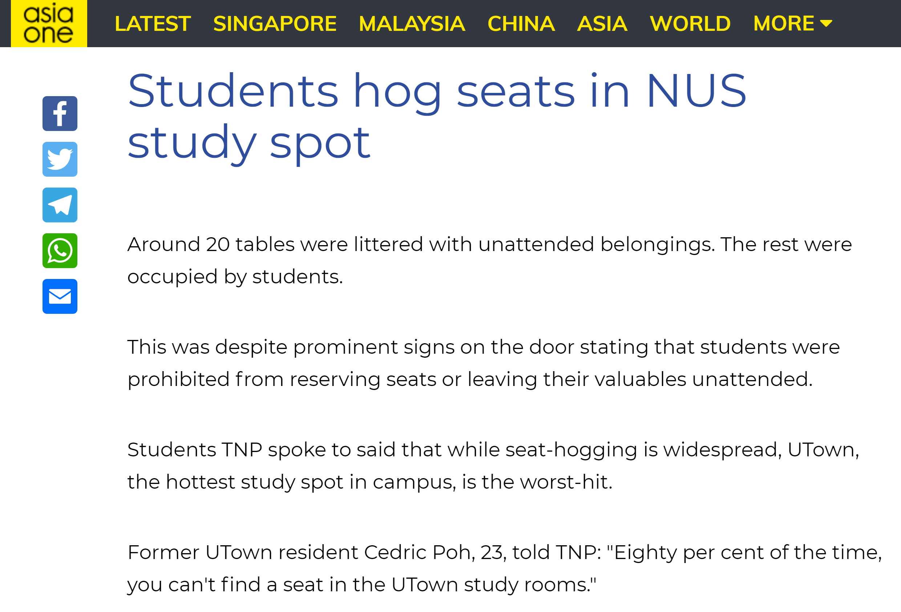
Public opinions about seat hogging
… everybody feels the same way ...
Notes:
These are screenshots of some opinions on public forums. Everybody feels the same way about the issue.Libraries are shared spaces and everybody should be able to enjoy it.

Slide 4


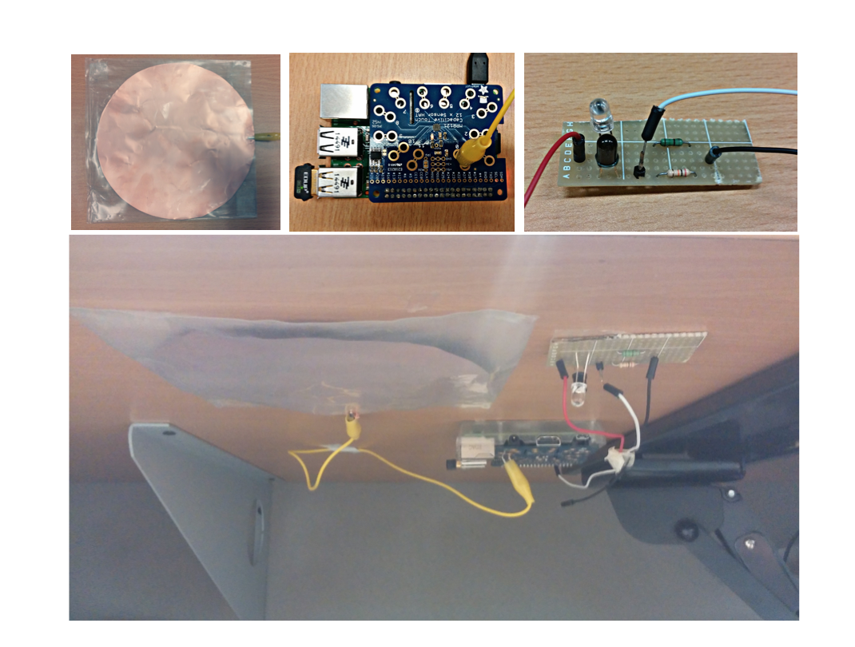
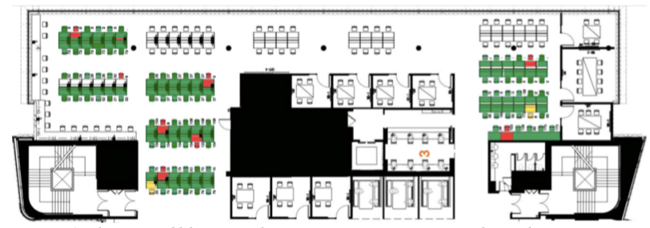
Active research in local academia
Research evaluating the effectiveness of different sensors in detecting seat occupancy.
Sensors such as :
Capacitance sensor
Infrared sensor
Seat map showing the seat occupancy status
Notes:
Research by SMU PHD students where they track the seat occupancy using sensors such as infrared sensor and capacitance sensors.
References: NGUYEN, Huy Hoang; GULATI, Nakul; LEE, Youngki; and BALAN, Rajesh Krishna. Real-time Detection of Seat Occupancy and Hogging. (2015). IoT-App '15: Proceedings of the 2015 International Workshop on Internet of Things towards Applications: Seoul, Korea, November 1.29-34. Research Collection School Of Information Systems.

Slide 5
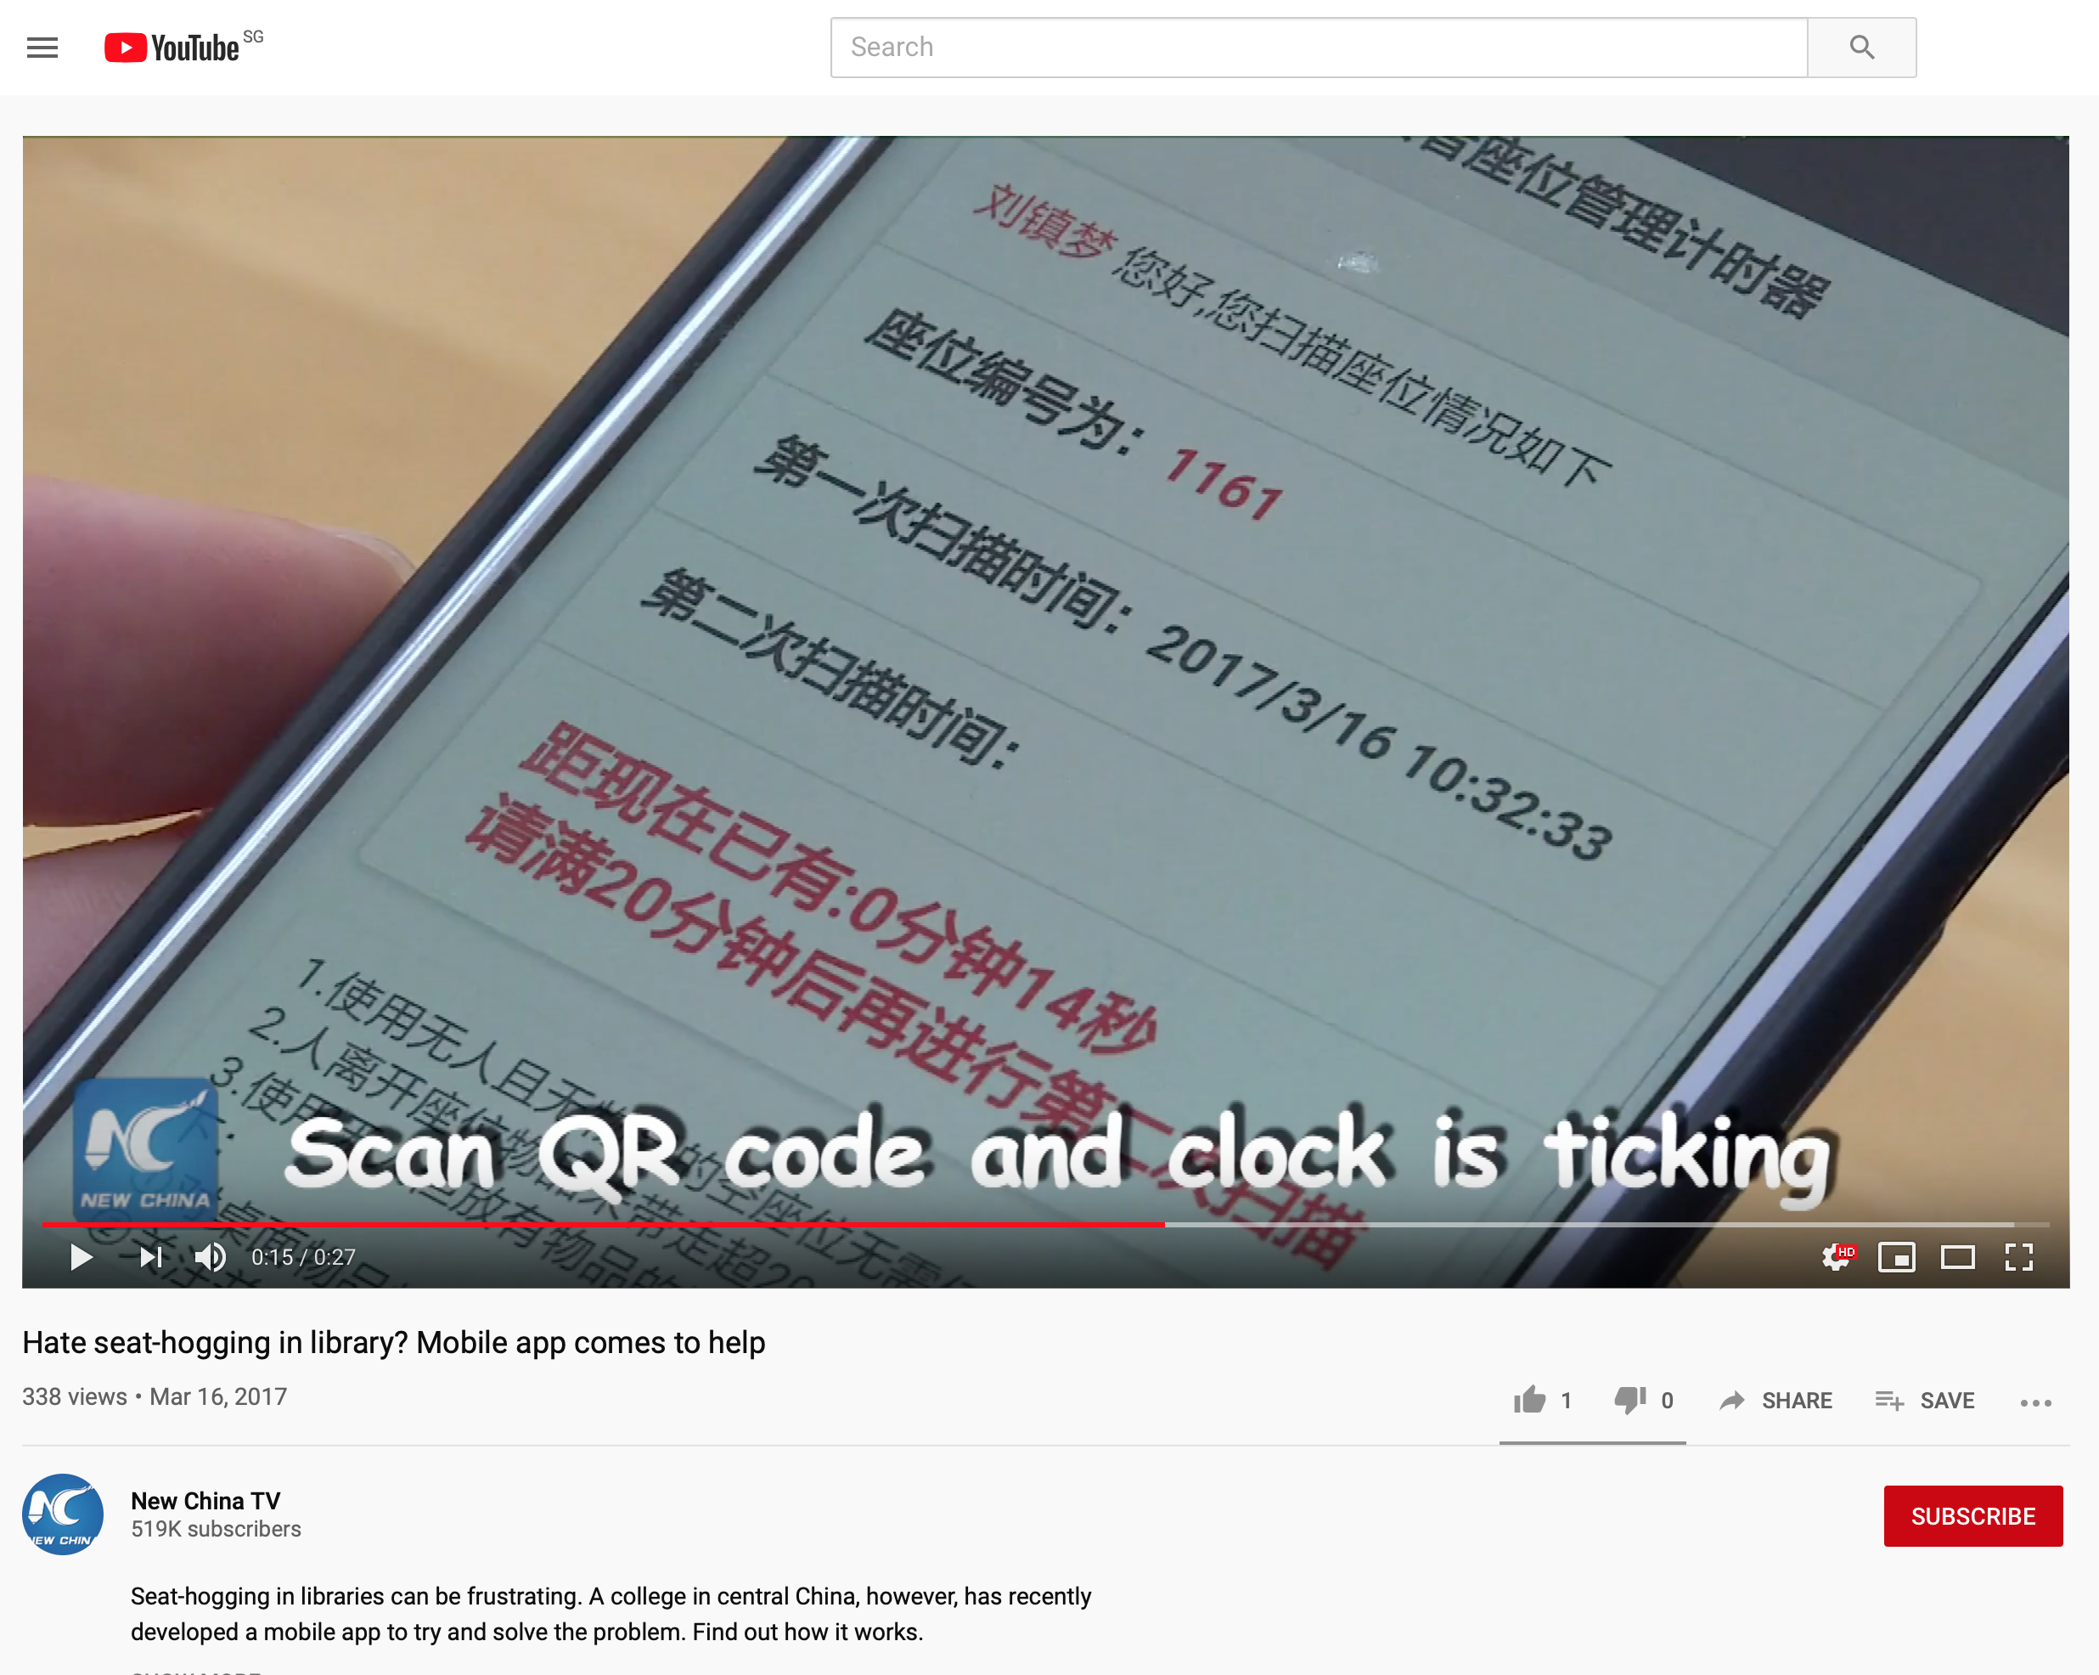
QR Code App in China
How it works:
Scan the QR code
If previous user does not return in 20 minutes, the seat is yours!
Limitations:
Students have to wait for 20 minutes
If not enforced, students might not follow
Notes:
Solution provided by a college in central china where they made a QR code app to decide the occupant of the seat.

Slide 6
Reframing the problem
Maybe the problem isn’t seat hogging …
How about we focus on SEAT MANAGEMENT instead?
How might we help librarians manage the problem of seat hogging better?
Notes:
Is seat hogging really the problem?
This is really a social problem
The best way is through policy
Reframe this into a problem about seat management.
How might we help librarians manage the problem of seat hogging better?

Slide 7
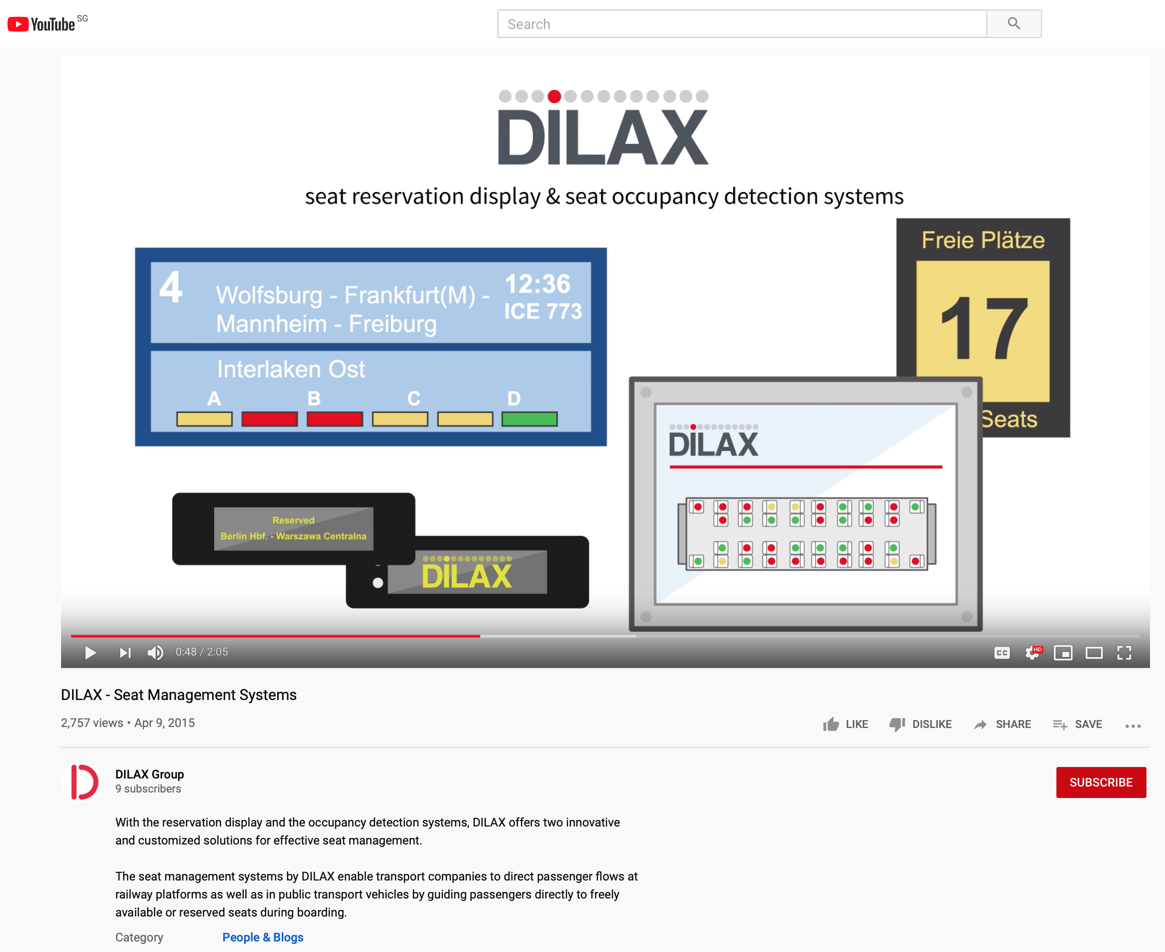
Seat management in transport sector
Collect seat occupancy data with sensors
Real-time
Intuitive display
Enable transport operators to manage crowd flow better
Notes:
Case study of seat management in another industry: DILAX
Very common solution seen in hackathons or IoT projects
Attach sensors to every seat
Provide seat occupancy data in real time
Visualise with an intuitive user interface
Enable transport operators to manage large crowds
Pretty legitimate solution in the transport sector

Slide 8
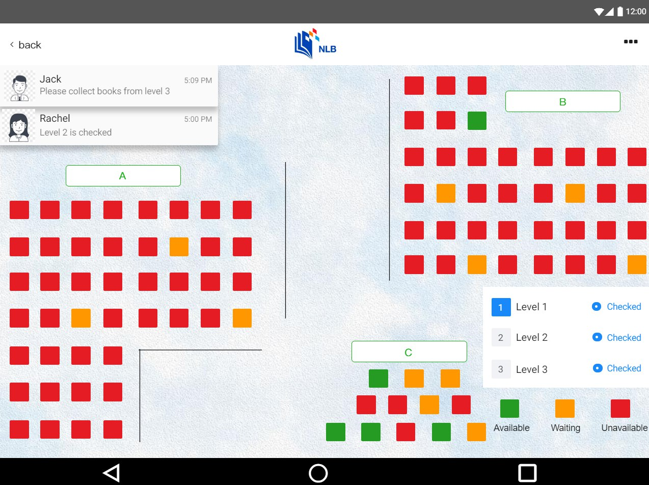
Seat management in public libraries?
Collect seat occupancy data with sensors
Real-time
Intuitive display
Enable librarians to manage seat hogging better
Notes:
Why don’t we import this idea into the public sector
We can be like DILAX—but for public libraries
Provide a seat management system to enable librarians to manage seat hogging better

Slide 9



Stakeholders
Constraints:
Constraints:
Constraints:
Needs:
“Oh man, I need to go out for a while. Will the librarian take my bag?”
Needs:
Needs:
“Should i remove the belongings of this seat since it is unused?”
“Should I clear this unattended bag?”
“So mafan, how to monitor all these seats more efficiently...”
“Sian, cannot find a seat”
“Ugh, I need to focus on my work”
Finding seats
Librarian
Occupants
Notes:
People who want to find seats
Need: find an empty seat to study within a short period of time
Want: easily find adjacent seats if you come with friends
Constraint: do not have the right to clear other people’s unattended belongings even if the seat is unused
Librarians:
Need: maintain order in the library and provide a conducive environment for people to walk in
Need: monitor all the seats efficiently, especially during peak hours
Constraint: Unsure of whether to clear unattended belongings in order to make space for other users
Constraint: have to constantly patrol around the library regularly, especially during peak hours
Occupants
Need: Want minimal distractions/ disturbances from the surroundings
Constraint: when they want to leave the seat for a break, they are not sure how long they can leave their belongings unattended for before they are cleared by the librarian.

Slide 10
Java Application interface integrated into NLB application
Librarians:
Collate data from the sensors alongside real-time to show if the seat is occupied/ how long it has been occupied for.
Users:
The database will be integrated into the NLB mobile app as well as onto a monitor at the entrance of the library, which informs users of the seat availability in the library.

Slide 11
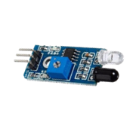
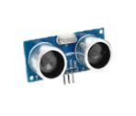

Solution
Sensors
Database using Firebase
Infrared Sensor:
Detect human presence by sensing its body heat.
Ultrasonic Sensor:
Detect if there is any item left on the table
Results from the sensors will be stored into the Database in real time

Slide 12
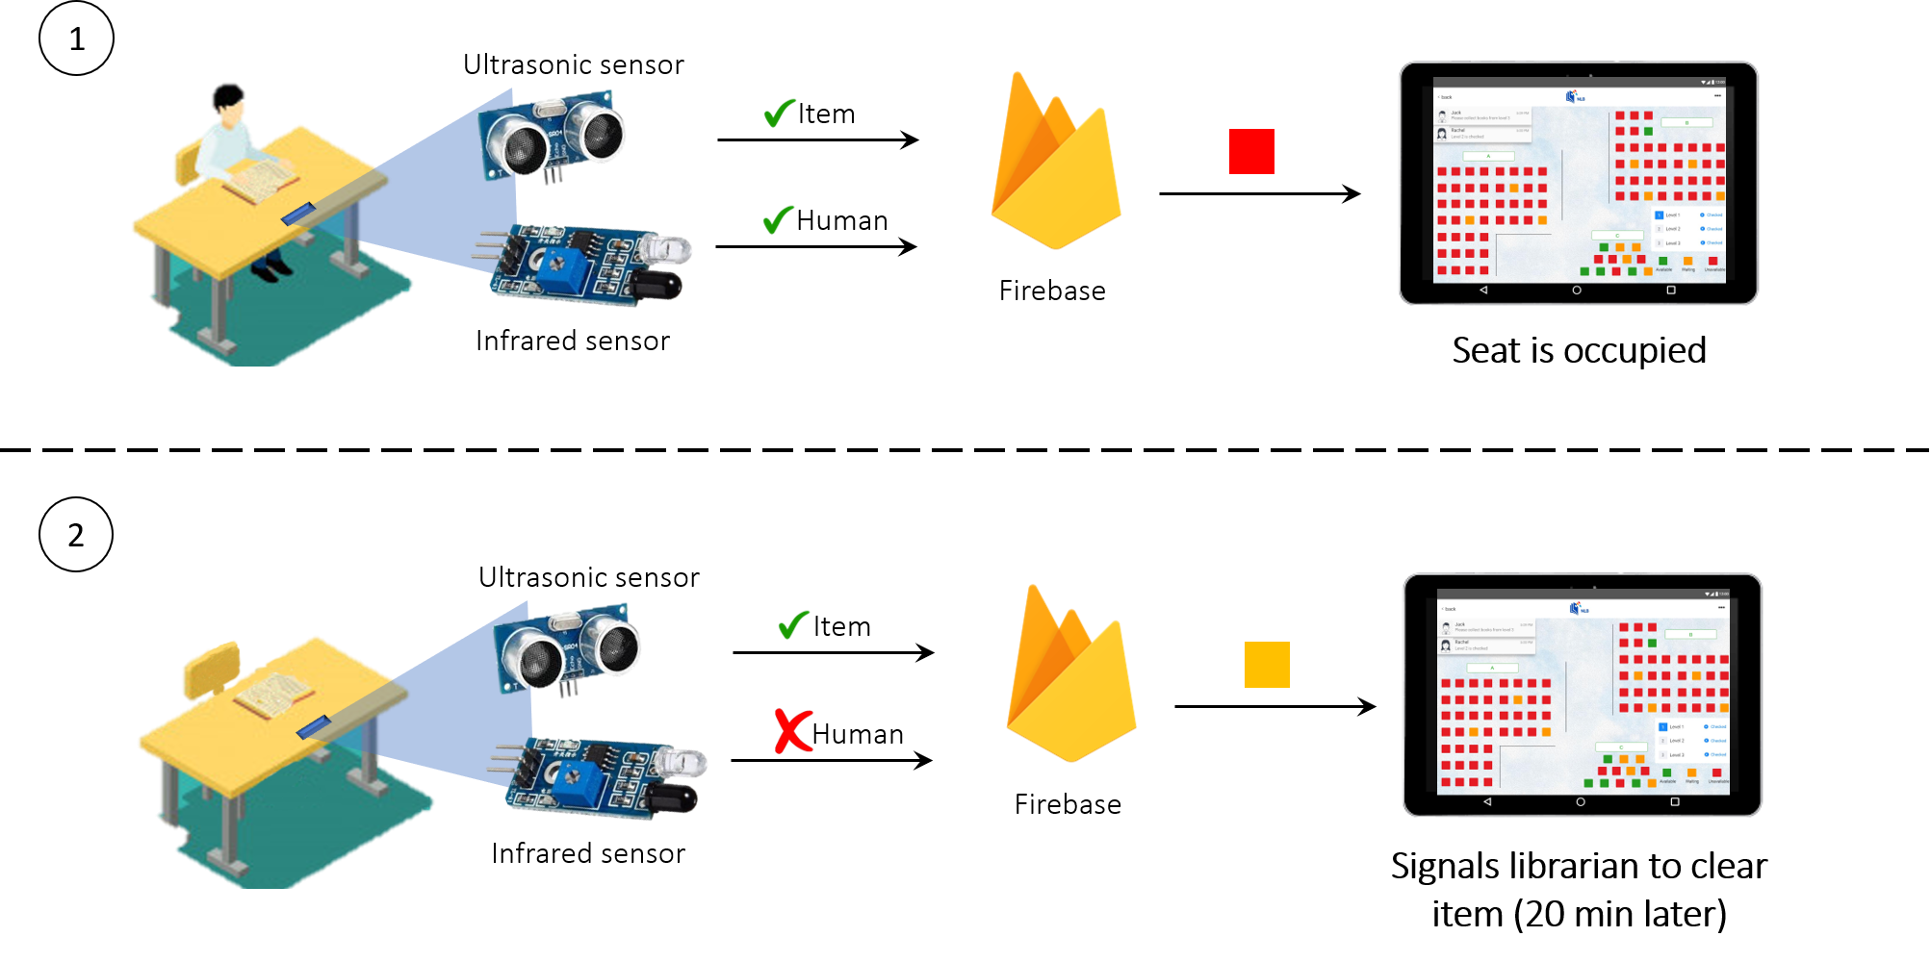
Solution Overview
Notes:
How it will be implemented
Both the sensors (in a container) will be placed on the table and directed toward the person.
Ultrasonic sensor will detect the presence of human seating
Infrared sensor will detect if there is any item placed on the table
This information will then be updated real-time on the firebase, and then the update will automatically change the seat status on the app.
First case - Presence of Human (regardless of presence of item)
Seat status will be red, meaning the seat is occupied, even if there is no item on the table.
Second case - Absence of Human, Presence of Item
The person has left but he could be chopping the seat for himself later.
Seat status will be changed to orange.
And if the person does not return after 20 minutes, the librarian will be notified on the app to clear the items to make space for the next person.

Slide 13
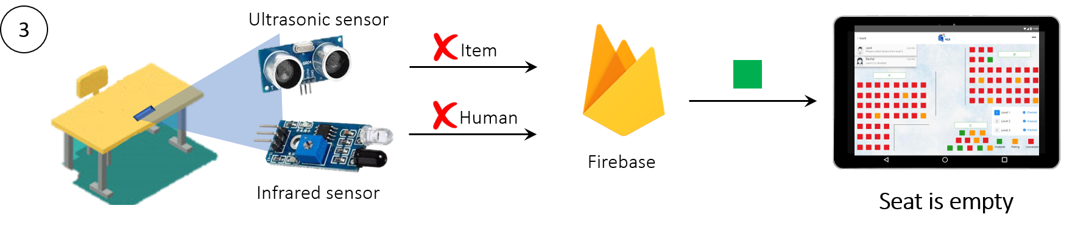
Solution Overview
Notes:
Third case - Absence of Human, Absence of Item
The librarian has cleared the item, or if the person has left the seat and removed all his belongings.
Seat status will be changed to green, meaning the seat is empty so that the next person can come and use this seat.
We then go back to the first case

Slide 14



Advantages of our solution
Cheap (e.g. sensors, 3D printing)
Empowers the authority
Applicable to other sectors:
Scalability (e.g. cafes)
Versatility (e.g. hawker centres)

Slide 15

Project Schedule
1st - 15th Nov (Week 8-9): Assemble the prototype using strip board, Start making the app
By end Nov (Week 11):
Construction of the actual prototype and finalisation of the application
6 Dec (end of Week 12):
Project showcase
By end Oct (Recess week):
Purchase equipment (e.g. sensor), functional testing of sensor
16-22st Nov (Week 10):
Complete testing of prototype for both hardware and software
2 Dec (Week 12):
Project checkoff

